Slide 1
Understanding The Bible
The Purpose of the Bible
The Land of the Bible
The Story of the Bible – Old Testament
The Story of the Bible – New Testament
The Infant Church
The Message of the Bible
The Authority of the Bible
The Interpretation of the Bible
The Use of the Bible
__________________________________________________________________________________________________________________________________
ALL WORD NOTES AND POWERPOINT PRESENTATIONS ARE AVAILABLE AT www.BethlehemChristian.org/bible

Slide 2
When the day of Pentecost arrived, they were all together in one place. And suddenly there came from heaven a sound like a mighty rushing wind, and it filled the entire house where they were sitting. And divided tongues as of fire appeared to them and rested on each one of them. And they were all filled with the Holy Spirit and began to speak in other tongues as the Spirit gave them utterance. (Acts 2:1-4 ESV)
Now there were dwelling in Jerusalem Jews, devout men from every nation under heaven. And at this sound the multitude came together, and they were bewildered, because each one was hearing them speak in his own language. And they were amazed and astonished, saying, “Are not all these who are speaking Galileans? And how is it that we hear, each of us in his own native language? … we hear them telling in our own tongues the mighty works of God.” And all were amazed and perplexed, saying to one another, “What does this mean?” (Acts 2:5-8, 11b, 12 ESV)

Slide 3
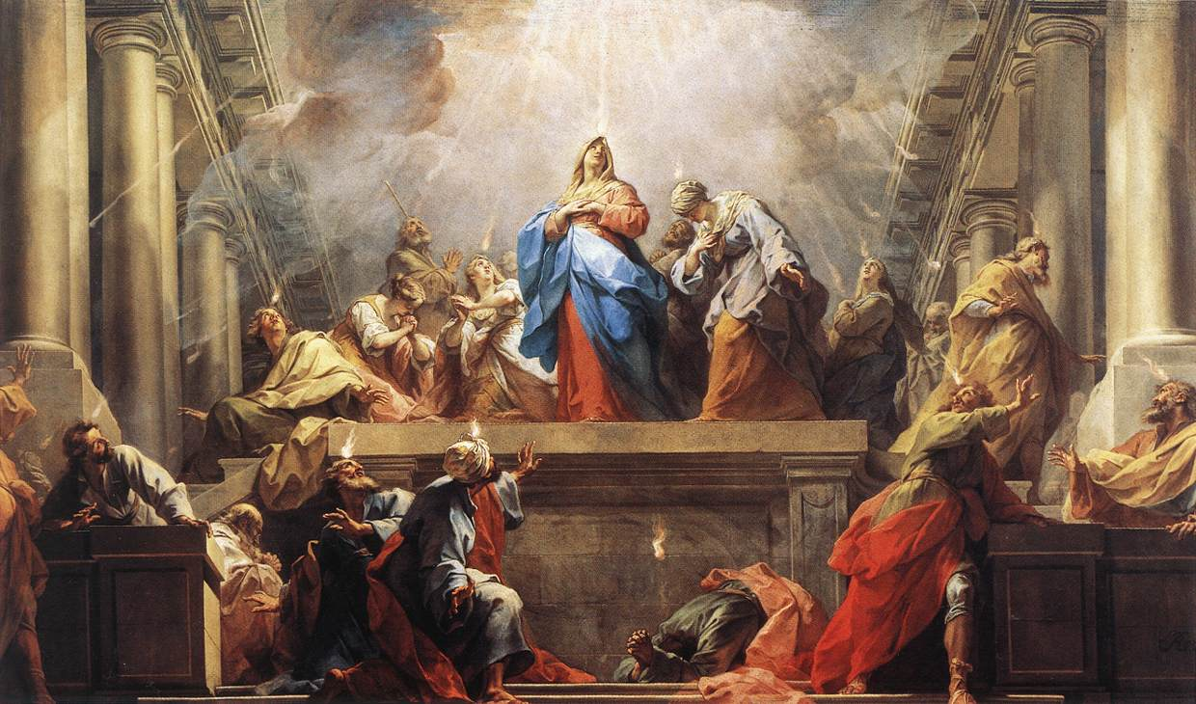

Slide 4
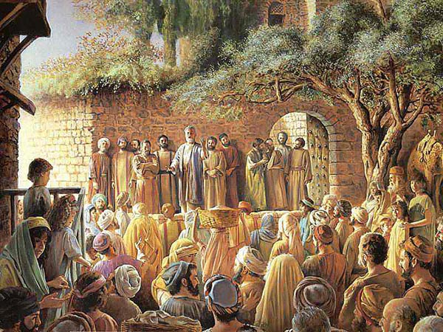

Slide 5
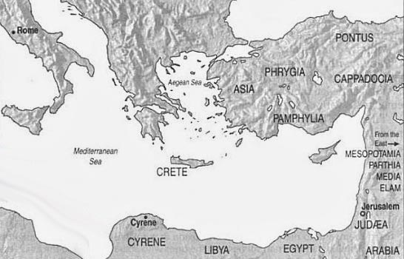
COUNTRIES OF PEOPLE MENTIONED AT PENTECOST

Slide 6
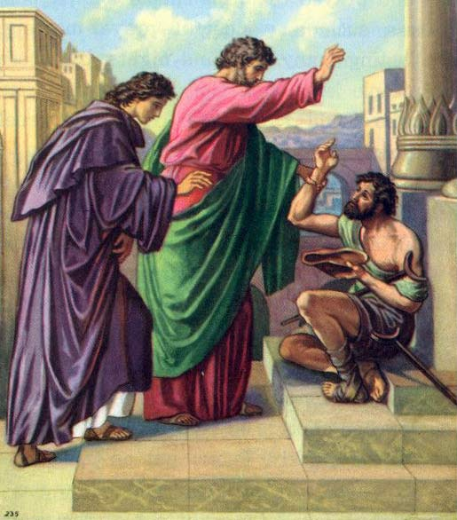

Slide 7
But Peter and the apostles answered, “We must obey God rather than men. The God of our fathers raised Jesus, whom you killed by hanging him on a tree. God exalted him at his right hand as Leader and Savior, to give repentance to Israel and forgiveness of sins. And we are witnesses to these things, and so is the Holy Spirit, whom God has given to those who obey him.” (Acts 5:29-32 ESV)

Slide 8
(I) And as [Peter and John] were speaking to the people, the priests and the captain of the temple and the Sadducees came upon them, greatly annoyed because they were teaching the people and proclaiming in Jesus the resurrection from the dead. And they arrested them and put them in custody until the next day, for it was already evening. (Acts 4:1-3 ESV)
But Peter and John answered them, “Whether it is right in the sight of God to listen to you rather than to God, you must judge, for we cannot but speak of what we have seen and heard.” (Acts 4:19, 20 ESV)

Slide 9
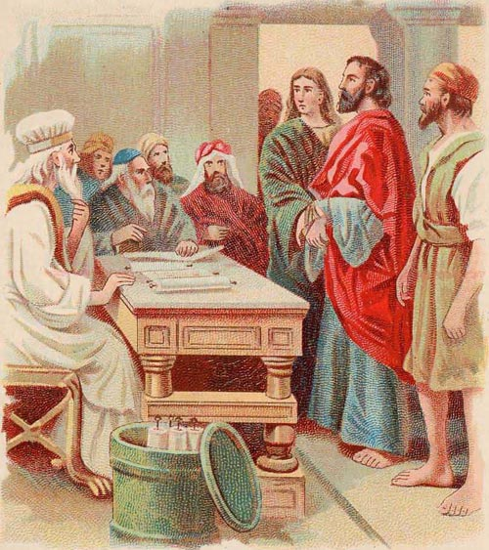

Slide 10
(II) But the high priest rose up, and all who were with him (that is, the party of the Sadducees), and filled with jealousy they arrested the apostles and put them in the public prison. (Acts 5:17, 18 ESV)

Slide 11
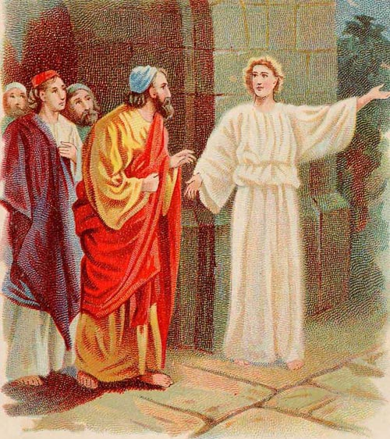

Slide 12
(III) Then the captain with the officers went and brought them, but not by force, for they were afraid of being stoned by the people. And when they had brought them, they set them before the council. (Acts 5:26, 27a ESV)
But a Pharisee in the council named Gamaliel, a teacher of the law held in honor by all the people, stood up and gave orders to put the [apostles] outside for a little while. And he said to [the Sanhedrin], “Men of Israel, take care what you are about to do with these men. … I tell you, keep away from these men and let them alone, for if this plan or this undertaking is of man, it will fail; but if it is of God, you will not be able to overthrow them. You might even be found opposing God!” So they took his advice, (Acts 5:34, 35, 38b, 39 ESV)

Slide 13
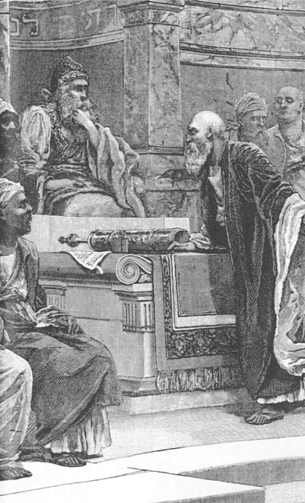

Slide 14
There was not a needy person among [those who believed], for as many as were owners of lands or houses sold them and brought the proceeds of what was sold and laid it at the apostles' feet, and it was distributed to each as any had need. (Acts 4:34, 35 ESV)

Slide 15
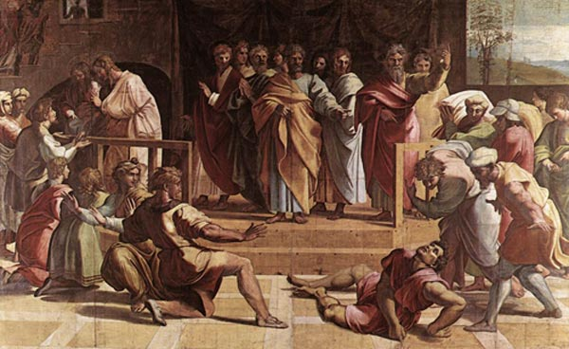

Slide 16
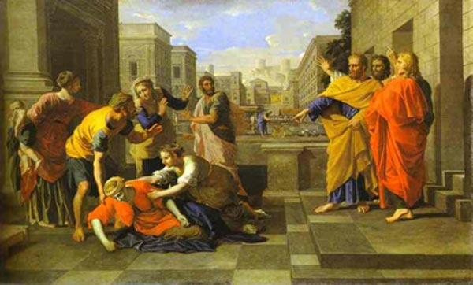

Slide 17
Now in these days when the disciples were increasing in number, a complaint by the Hellenists arose against the Hebrews because their widows were being neglected in the daily distribution. And the twelve summoned the full number of the disciples and said, “It is not right that we should give up preaching the word of God to serve tables. (Acts 6:1, 2 ESV)

Slide 18
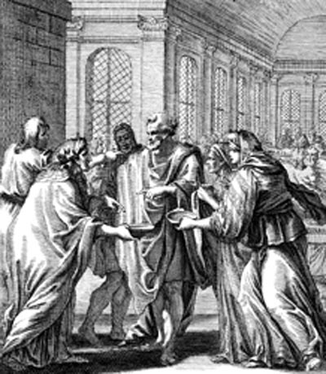

Slide 19
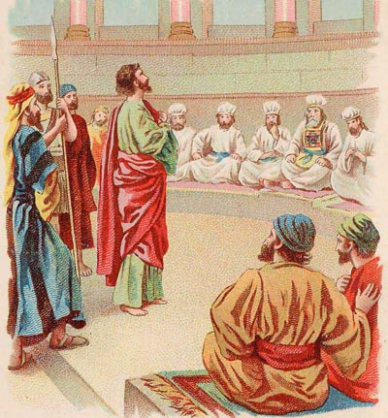

Slide 20
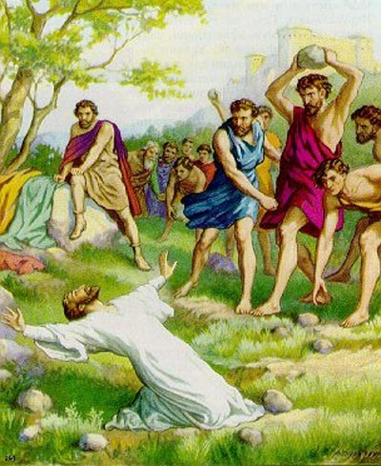

Slide 21
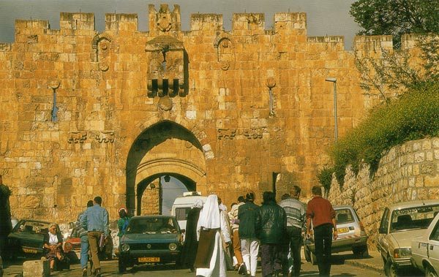

Slide 22
And there arose on [the day Stephen was stoned] a great persecution against the church in Jerusalem, and they were all scattered throughout the regions of Judea and Samaria, except the apostles. … Now those who were scattered went about preaching the word. (Acts 8:1b, 4 ESV)

Slide 23
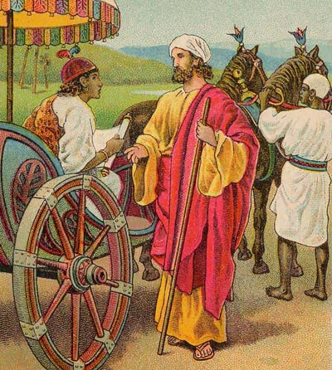

Slide 24
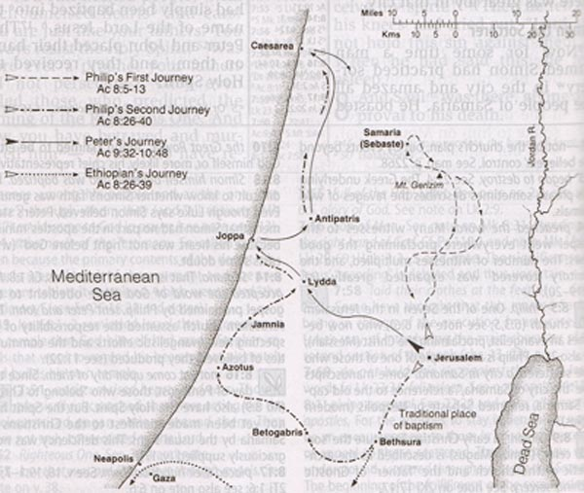

Slide 25
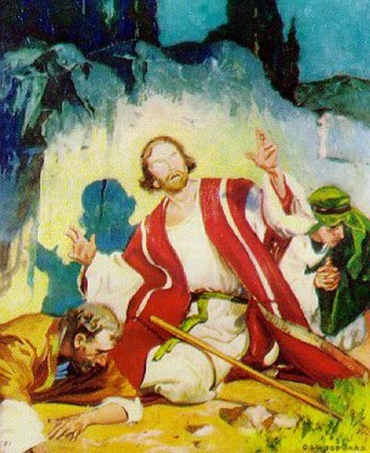

Slide 26
And the witnesses [who stoned Stephen] laid down their garments at the feet of a young man named Saul … And Saul approved of [Stephen’s] execution … Saul was ravaging the church, and entering house after house, he dragged off men and women and committed them to prison. (Acts 7:58b, 8:1a, 2, 3 ESV)
But the Lord said to [Annanias], “Go, for he is a chosen instrument of mine to carry my name before the Gentiles and kings and the children of Israel. (Acts 9:15 ESV)

Slide 27
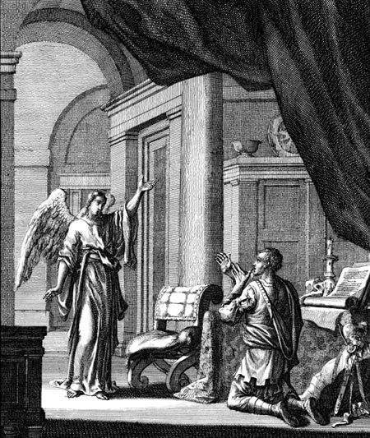

Slide 28
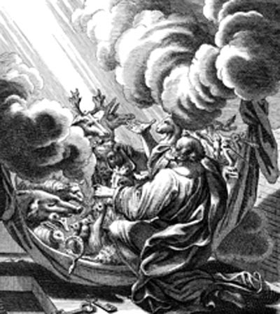

Slide 29
Understanding The Bible
The Purpose of the Bible
The Land of the Bible
The Story of the Bible – Old Testament
The Story of the Bible – New Testament
The Infant Church
The Message of the Bible
The Authority of the Bible
The Interpretation of the Bible
The Use of the Bible
__________________________________________________________________________________________________________________________________
ALL WORD NOTES AND POWERPOINT PRESENTATIONS ARE AVAILABLE AT www.BethlehemChristian.org/bible

